Slide 1
FINANCE MANAGEMENT

Slide 2
Financial management deals with how the corporation obtain the funds and how it uses them.
Financial management may also be defined as “that part of management, which is concerned mainly with raising the funds for the enterprise in the most economical manner.
Utilising those funds as profitably as possible for a given risk level, planning future investments and controlling current performance and future developments through accounting, budgeting and other means”.

Slide 3
Functions
1) Financial planning and control
2) Determination of capital requirements
3) Acquisition of funds by determining the financing mix
4) Allocation of capital funds
5) Management of current assets
6) Determination of dividend payout ratio

Slide 4
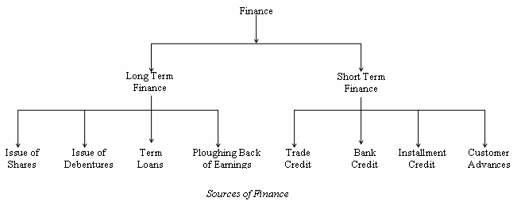
Sources of Finance

Slide 5
Issue of Shares
The most important source of long term fund is issue of shares.
The company invites members of the public through its prospectus to purchase shares and the persons who purchase the shares are called share holders.
The liability of the share holders is limited to their capital contributions and they are entitled to transfer shares.

Slide 6
Issue of Debentures
A debenture is an acknowledgement of debt issued under the seal of the company.
Debentures are issued by the company when it wants to raise the money without increasing its share capital.

Slide 7
Term Loans
Term loan refers to long term financial assistance that is generally repayable in more than one year but less than ten years.
The repayment of principal amount of the term loan plus interest is a statutory obligation irrespective of the financial position of the company.

Slide 8
Ploughing Back of Earnings
Under this system, the entire profit generated by the company will not be distributed among the share holders or owners, but a portion of it will be retained by the company to serve as a source of finance for expansion and growth of the concern.
This is also referred to as internal financing or self financing.

Slide 9
Trade Credit
This represents the credit granted by other firms or suppliers, usually for a period of thirty to ninety days.
Trade credit is usually granted to the company on the basis of its good will and also the financial position.
Bank Credit
This is an important source of short term finance and may be in the form of advances, loans, cash credits, overdrafts, etc.

Slide 10
Installment Credit
This type of finance is generally employed by the companies to purchase equipments and machinery and the payment is made on easy instalments.
Customer Advances
These advances are obtained from the customers at the time of ordering or booking of the product and it represents a part of the product cost.
The period of such credit will depend upon the time taken to deliver the product.

Slide 11
Inflation
Inflation is the rate at which the general level of prices of goods and services is rising and consequently the purchasing power of currency is falling.
It is measured as an annual percentage increase.
As inflation rises, every Rupee you own buys a smaller percentage of a good or service.

Slide 12
Types of Inflation
Demand-pull Inflation
This type of inflation occurs when total demand for goods and services in an economy exceeds the supply of the same.
When the supply is less, the prices of these goods and services would rise, leading to a situation called as demand-pull inflation.
This type of inflation affects the market economy adversely during the wartime.

Slide 13
Cost-push Inflation
As the name suggests, if there is increase in the cost of production of goods and services, there is likely to be a forceful increase in the prices of finished goods and services.
For instance, a rise in the wages of workers would raise the unit costs of production and this would lead to rise in prices for the related end product.
This type of inflation may or may not occur in conjunction with demand-pull inflation.

Slide 14
Pricing Power Inflation
Pricing power inflation is more often called as administered price inflation.
This type of inflation occurs when the business houses and industries decide to increase the price of their respective goods and services to increase their profit margins.

Slide 15
Sectoral Inflation
This type of inflation takes place when there is an increase in the price of the goods and services produced by a certain sector of industries.
For instance, an increase in the cost of crude oil would directly affect all the other sectors, which are directly related to the oil industry.

Slide 16
Cost
It’s the value of money used to produce something.
Classified into 2 types:
Direct Cost: Direct costs are those which can be identified with or related to the product or services.
An increase or decrease of a unit of product or service will affect the cost proportionately.
Indirect Cost : which cannot be identified or traced to a given cost object but are related to the expenses incurred for maintaining facilities for such production or services.

Slide 17
Overhead
Thus, the elements of cost may be summarised as follows –
(a) Direct materials cost and indirect materials cost
(b) Direct wages and indirect wages
(c) Direct expense and indirect expense
The aggregate of direct materials cost, direct wages and direct expense is called Prime cost
The aggregate of indirect materials cost, indirect wages and indirect expenses are collectively called Overhead Cost.
Or
Overhead Cost refers to any costs not specifically or directly associated with the production of identifiable goods or services.

Slide 18
Overheads are classified into :
Production overheads:- i.e. indirect costs relating to manufacturing activities.
Administration overheads:- i.e. costs relating to formulating the policy, directing the organisation and controlling operations.
Selling and distribution overheads:- i.e. indirect costs relating to the activity of creating and stimulating demand and securing orders as well as operations relating to distribution of goods from factory warehouse to customers.

Slide 19
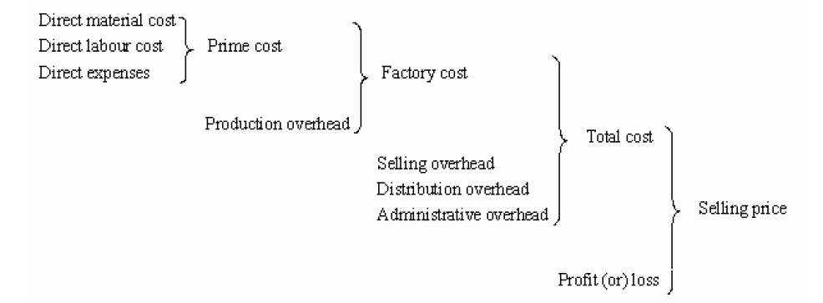
Elements of cost

Slide 20
Allocation of Overheads
If an industry is making only one product, a uniform charge for overhead may be possible.
But if a number of different products are being manufactured, an equitable base must be sought out to charge each product with a fair and reasonable share of the overhead cost, so that the total cost of each unit may be calculated.

Slide 21
Methods for the allocation of Overheads :
1) Direct material cost method
Overhead for an item = (Factory overhead × Direct material cost of the item concerned) / Total direct material cost
2) Direct labour cost method
Overhead for an item = (Factory overhead × Direct labour cost of the item concerned) / Total direct labour cost

Slide 22
3) Prime cost method
Overhead for an item = (Factory overhead × Prime cost of the item concerned) / Total prime cost
4) Labour hour rate method
Overhead for an item = (Factory overhead × Labour hours associated with the item concerned) / Total labour hours

Slide 23
5) Machine hour rate method
Overhead for an item = (Factory overhead × Machine hours associated with the item concerned) / Total machine hours
6) Production Unit method
Overhead associated with a production order = (Factory overhead × Number of units produced as per the production order ) / Total production in terms of units

Slide 24
Standard Costing Vs. Marginal Costing
Standard costing
Standard cost is defined as a predetermined cost which is calculated from management standards of efficient operations and the relevant necessary expenditure.
They are the predetermined costs on technical estimate of material, labour and overhead for a selected period of time and for a prescribed set of working conditions.
In other words, a standard cost is a planned cost for a unit of product or service rendered.

Slide 25
The technique of using standard costs for the purposes of cost control is known as Standard costing.
It is a system of cost accounting which is designed to find out how much should be the cost of a product under the existing conditions.
The predetermined cost is compared to the actual cost and a variance between the two enables the management to take necessary corrective measures.

Slide 26
Marginal cost
Marginal cost means the cost of the marginal or last unit produced.
It is also defined as the cost of one more or one less unit produced besides existing level of production.
The marginal cost of a product is its Variable cost.
Normally taken to be direct labour, direct material, direct expenses and the variable part of overheads.

Slide 27
Marginal costing technique has given birth to a very useful concept of called “Contribution” where contribution is given by: Sales revenue less variable cost
Contribution may be defined as the “Profit before the recovery of fixed costs”.
Thus, contribution goes toward the recovery of fixed cost and profit, and is equal to fixed cost plus profit i.e.(C = F + P).
In case a firm neither makes profit nor suffers loss, contribution will be just equal to fixed cost (C = F). This is known as break even point.

